Slide 1


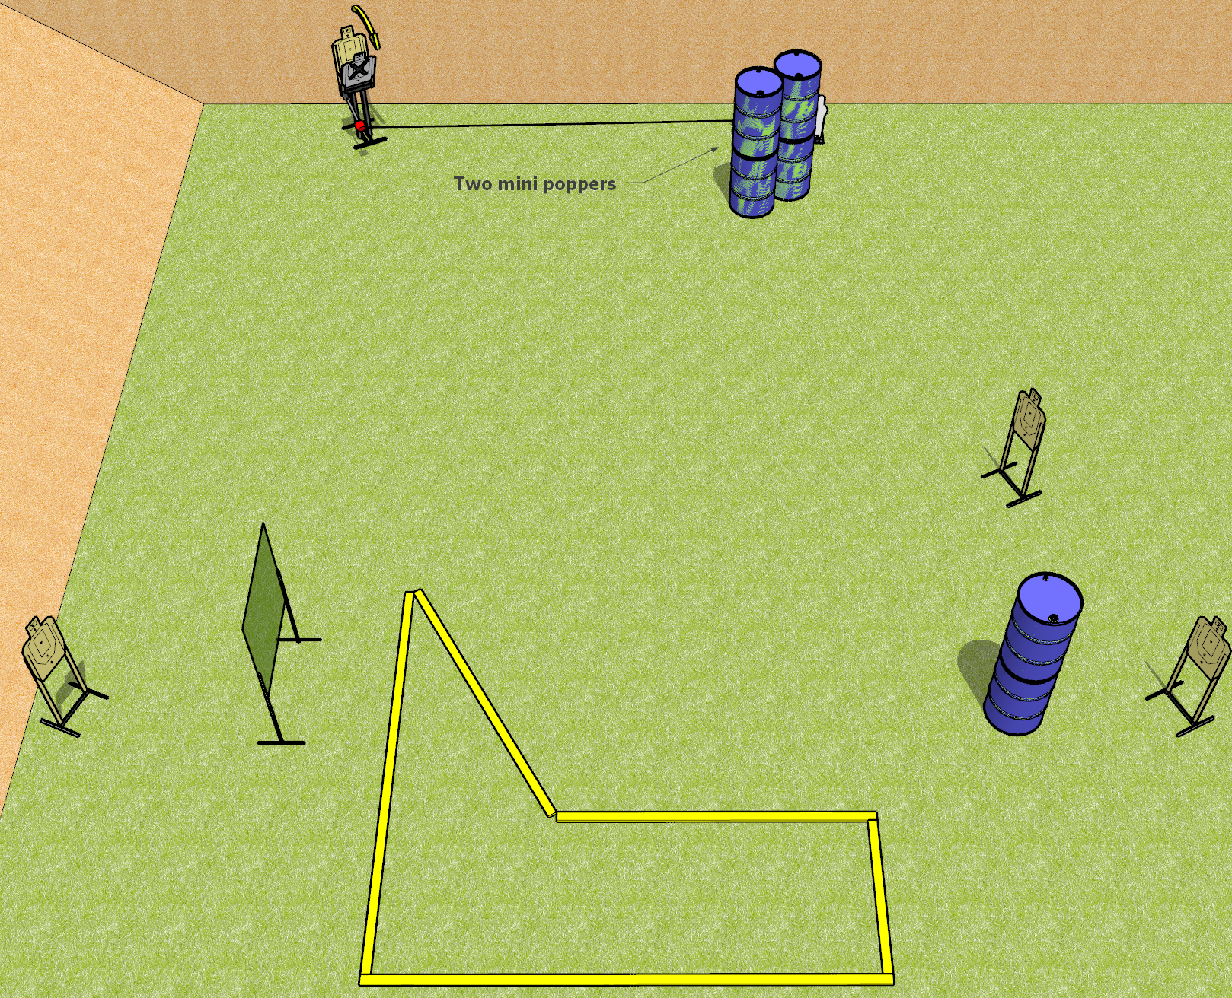
 | Dothan Gun Club – USPSA Match It Goes to 11 Course Designer : Drew Coleman
START POSITION : Straddling any fault line, one foot inside the shooting area other foot outside the shooting area not touching any fault line, wrists below belt
GUN READY CONDITION : Pistol loaded and holstered. PCC loaded, held with both hands, stock on belt, safety on. |  | SCORING: Comstock, 11 rounds TARGETS: 4 paper, 3 Steel SCORED HITS: Best 2 on paper, steel until down START-STOP: Audible, last shot RULES:
STAGE PROCEDURE: Engage targets as they become available from within the fault lines.

Slide 2
It Goes to 11
Written Stage Briefing
It Goes to 11 is an 11 round, 55 point, Comstock short course. There are four USPSA targets and three mini poppers. The best two hits on paper will score, and steel must fall to score. The start signal is audible.
The rightmost popper activates the max trap. The max trap must be activated before being engaged. Please check the activator prior to walk through and set it the same way every time for each shooter.
Handgun start position is straddling any fault line, one foot inside and the other foot completely outside not touching any fault line. Wrists below belt. Handgun is loaded and holstered.
PCC start position is straddling any fault line, one foot inside and the other foot completely outside not touching any fault line. Loaded carbine is held with both hands, safety on, stock on belt.
On start signal, engage targets as they become available from within the shooting area.

